Slide 1


Image Super Resolution Using SRCNN and ResDenseNet
Team 1: Yumeng Lu, Hongyang Li, Yimeng Zhang

Slide 2


An Old Blurred Image of Lin Huiyin
Low Resolution
High Resolution

Slide 3
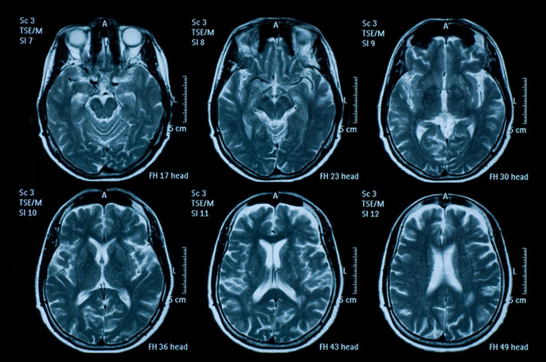
Information loss
small image
large image

Slide 4
What is super resolution? Why is super resolution important?
Task: to recover a high-resolution image from a lower-resolution image
Significance:
Important in computer vision and image processing
Enjoys a wide range of real-world applications
Medical imaging
Satellite imaging
Surveillance
Security
…

Slide 5
Agenda
Datasets
Machine Learning Models: SRCNN and Residual Dense Network
Architecture and Implementation
Technique
Metrics
Results
Discussions and Future Work

Slide 6

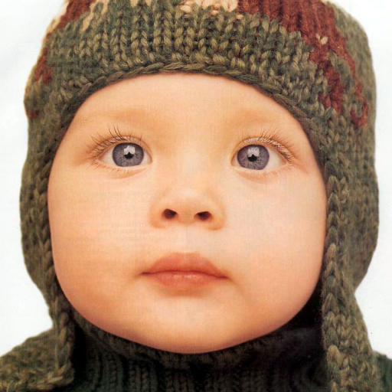



Datasets
91 Image
Set 5

Slide 7
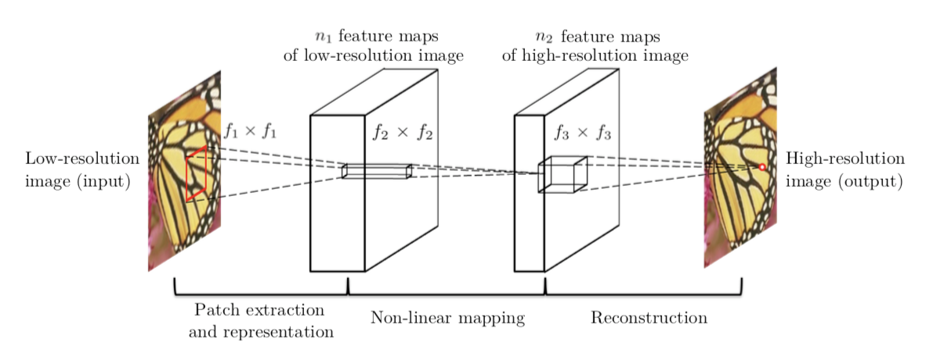
SRCNN— Architecture

Slide 8
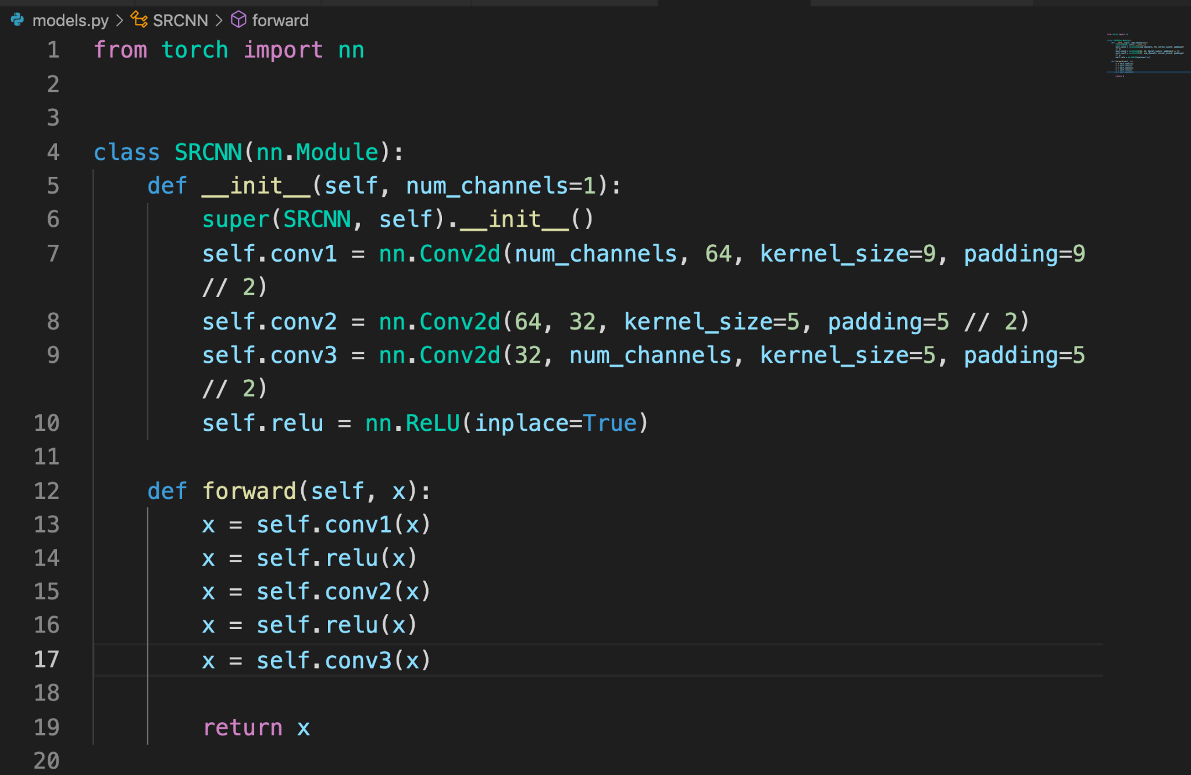

Slide 9
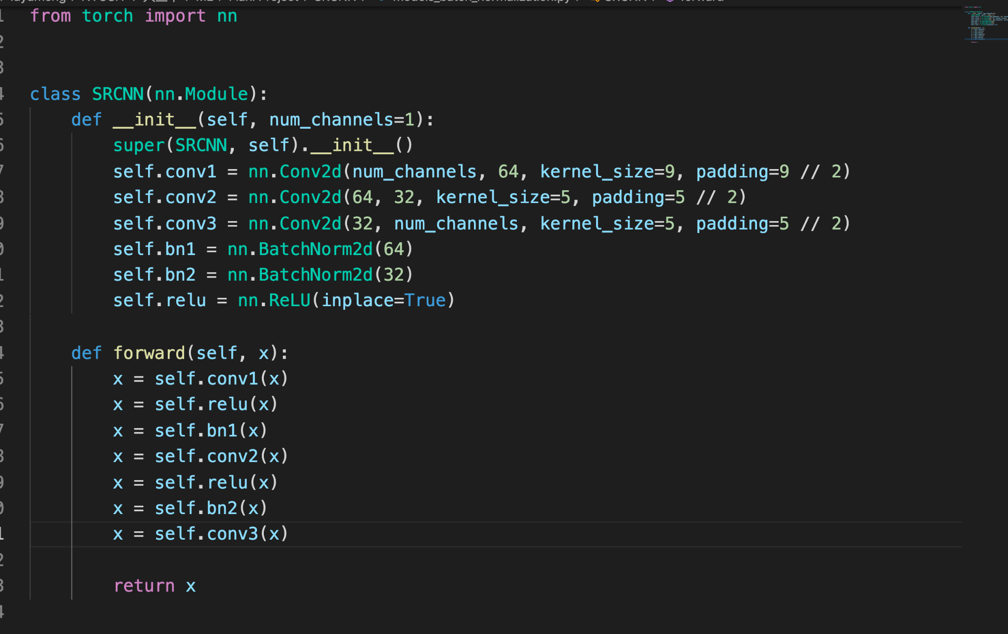
SRCNN Technique — Batch Normalization

Slide 10
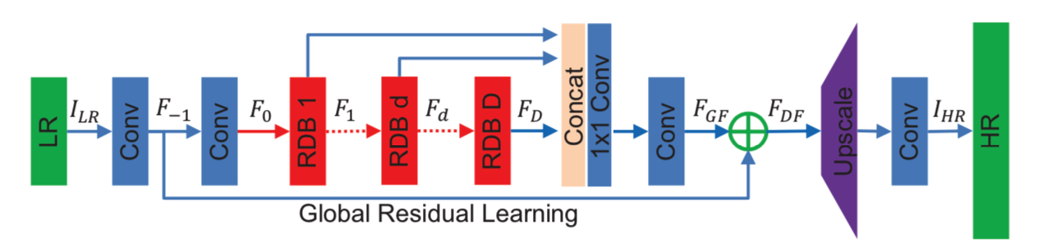

ResDenseNet (RDN) — Architecture
DFF
SFENet
UPNet
RDB
GFF
GRL
3✖️ 3 conv

Slide 11
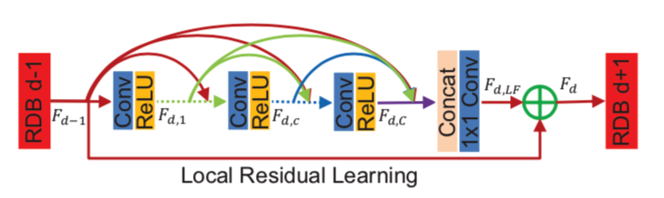
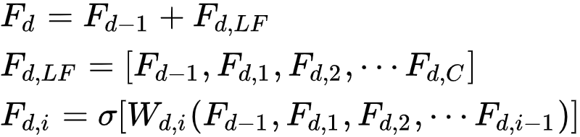
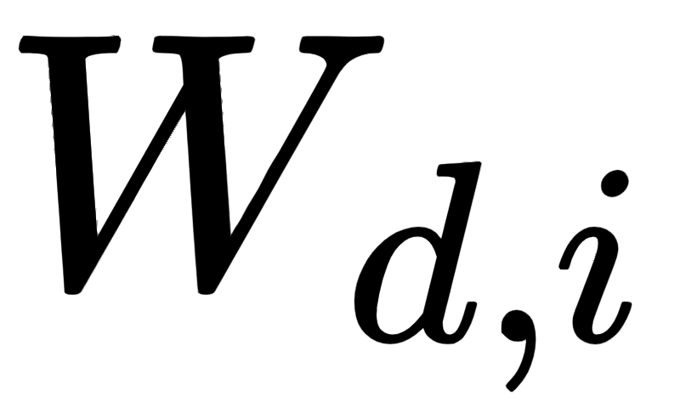
ResDenseNet (RDN) — Architecture (Continue)
1 ✖️ 1 conv
Here C is a hyperparameter and the larger the C, the better the performance is.
corresponds to the weights at Block d, layer i.

Slide 12
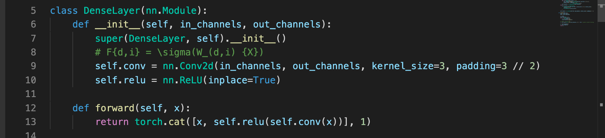
ResDenseNet (RDN) — Implementation

Slide 13
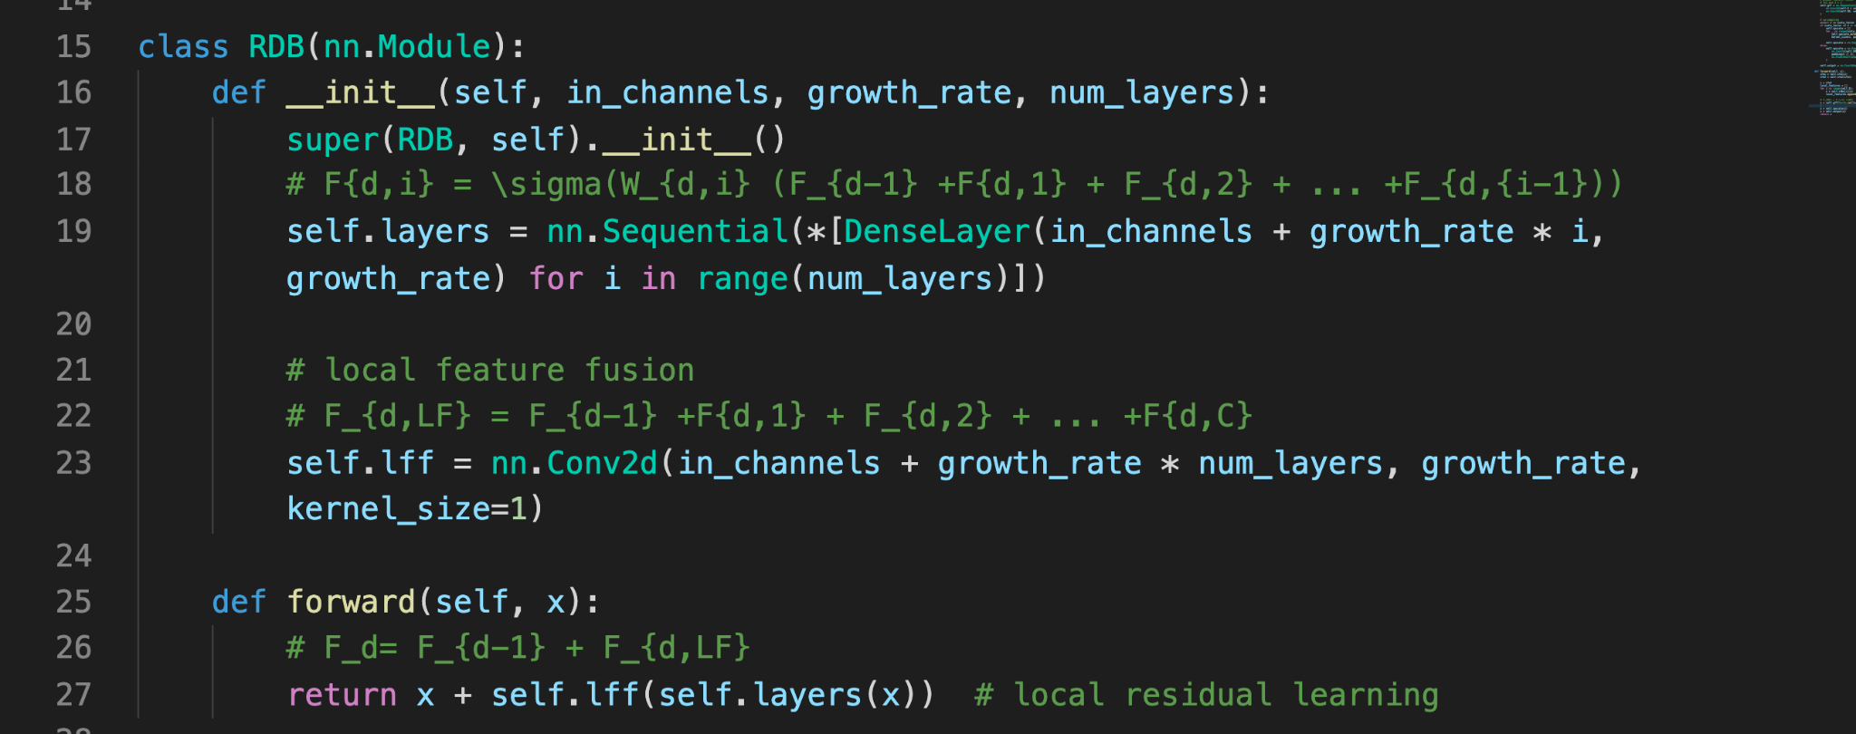

Slide 14
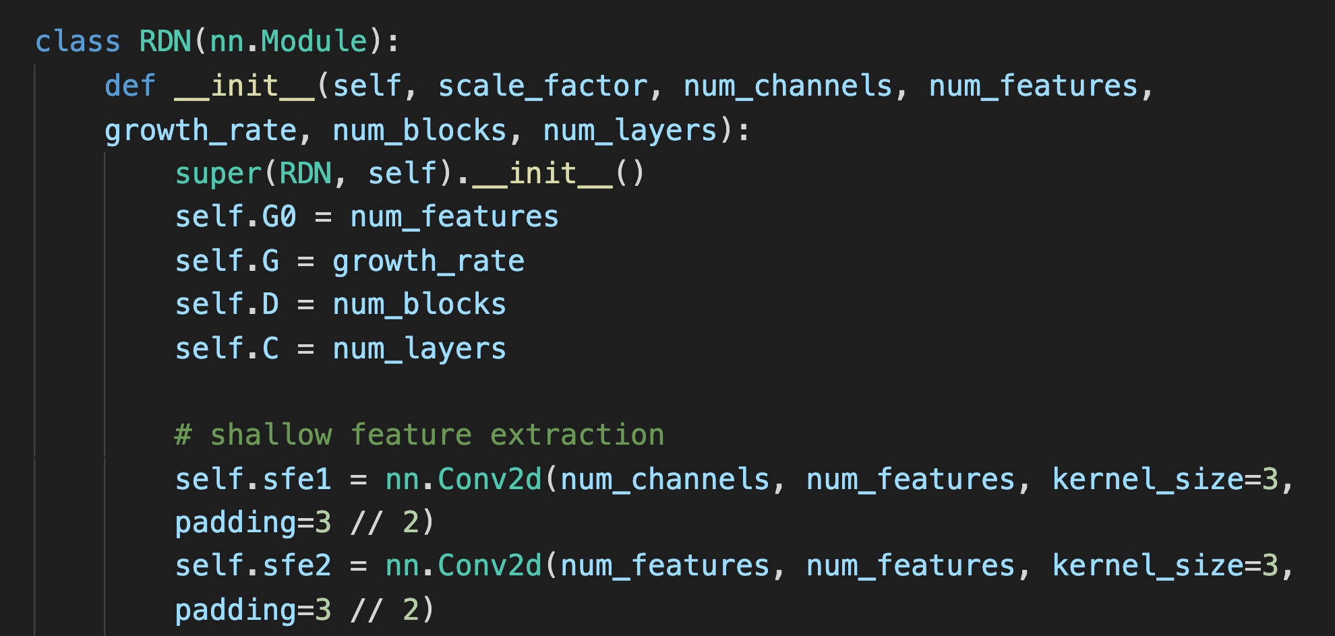

Slide 15
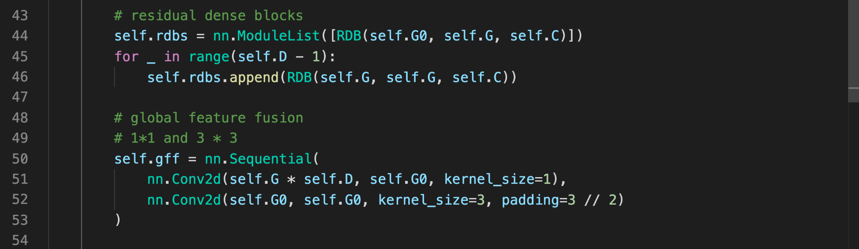

Slide 16
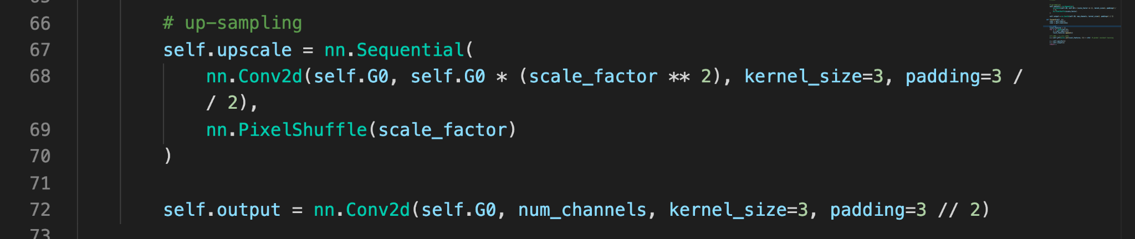

Slide 17
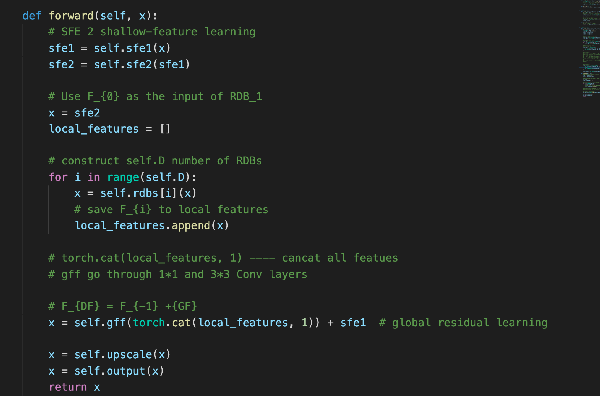

Slide 18
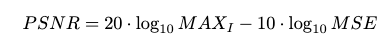
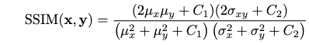
Evaluation Metrics for the Self-supervised Task
Peak Signal-to-Noise Ratio (PSNR) — quantifies reconstruction quality for images to lossy compression.
where MAXi is the maximum possible pixel value
Structure Similarity Index (SSIM) — tests the similarity between the output images and the ground truth images based on structural similarity.

Slide 19
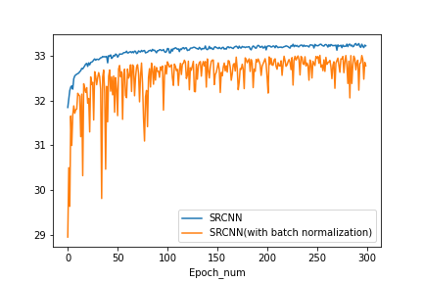
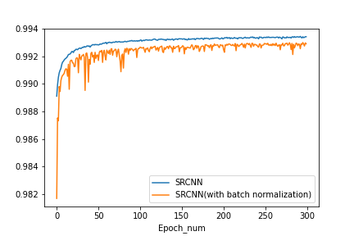
Results (1) — SRCNN
SRCNN v.s. SRCNN with Batch Normalization
Validation PSRN
Validation SSIM
SRCNN Discussion and Future Work:
Fluctuations — batch normalization
More optimizations

Slide 20
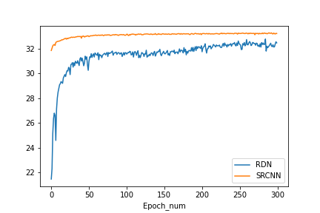
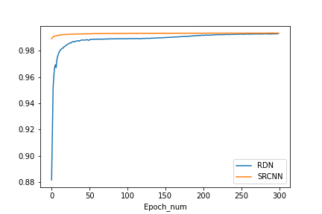
Results (2)
SRCNN v.s. ResDenseNet
Validation PSNR
Validation SSIM
RDN Discussion and Future Work
No overfitting yet — foreseeable better performance with more training epochs
Complex model needs more training data — DIV2K training set
Training set is more suitable for SRCNN than RDN

Slide 21
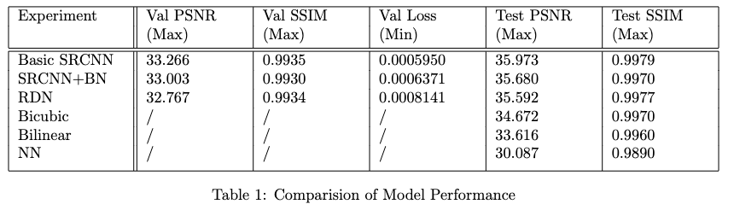
Results (3) — Summary Table

Slide 22



Results (4) — Testing Outputs
Bicubic RDN SRCNN

Slide 23



Bicubic RDN SRCNN

Slide 24



Bicubic RDN SRCNN

Slide 25
References
Chao Dong et al. “Image Super-Resolution Using Deep Convolutional Networks”. CoRR abs/1501.00092 (2015). arXiv: 1501.00092.
Zhou Wang, A. C. Bovik, H. R. Sheikh and E. P. Simoncelli, “Image quality assessment: from error visibility to structural similarity," IEEE Transactions on Image Processing, vol. 13, no. 4, pp. 600-612, April 2004.

Slide 26
Thank you!

